Slide 1
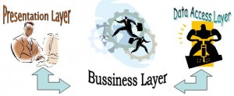

Three Tier Architecture in ASP.NET

Slide 2

Overview
Introduction
Client/Server Architecture
What is the client server model?
Advantages of client-server
Disadvantages of client-server
Client-server architectures
Tier vs. Layer
Two tier Architectures
3-Tier Architecture
Three Layer Architecture in C# .NET

Slide 3

Introduction
A long ago programmers used to write much lines of code and various logical functions and procedure to support reuse of their code.
Today’s applications demands
  Vast data support,
  User Interface Improvisation,
  Data security and dynamic business needs.
The 3-tier applications came into picture to solve developer’s problem.
Separating the tiers in applications helps programmer to concentrate on very particular logic and build strong and dynamic programming architecture to support business applications.

Slide 4
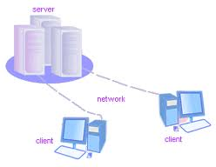
Client/Server Architecture
Use Database server
Query based approach
Reduced traffic, since required content is only transferred
Improves multi-user updating
RPC (Remote Procedure Call) or SQL typically used
A client is a computer or program that makes a request to a server
A server is a computer or program that processes the requests of multiple computers or programs

Slide 5
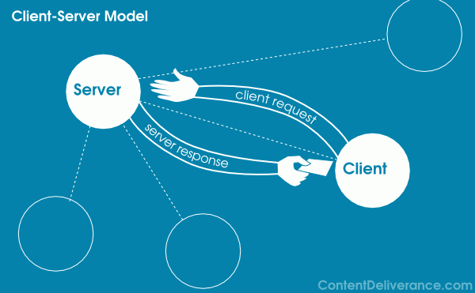
What is the client server model?
Client Server model is the relationship between the client and the server.
Examples of client server architecture:
Online Gaming
Surfing the internet

Slide 6

ADVANTAGES OF CLIENT-SERVER
Advantages often cited include:
  Centralization - access, resources, and data security are controlled through the server
  Scalability - any element can be upgraded when needed
  Flexibility - new technology can be easily integrated into the system
  Interoperability - all components (clients, network, servers) work together

Slide 7

DISADVANTAGES OF CLIENT-SERVER
Disadvantages often cited include:
  Dependability - when the server goes down, operations cease
  Lack of mature tools - it is a relatively new technology and needed tools are lacking
    e.g.. Automated client software distribution
  Lack of scalability - network operating systems (e.g.. Novell Netware, Windows NT Server) are not very scalable.
  Higher than anticipated costs
  Can cause network congestion

Slide 8
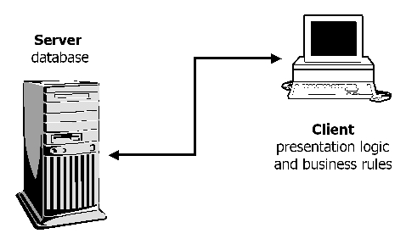
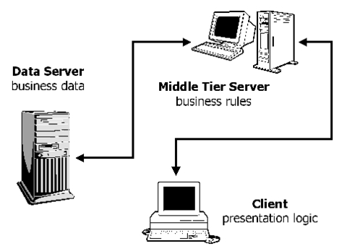
CLIENT-SERVER ARCHITECTURES
There are basically three types of client-server architectures
  Two tier architectures
  Three tier architectures
The choice between the two should be made based on combination of:
  Schedule for project implementation
  Expected system changes and enhancements

Slide 9
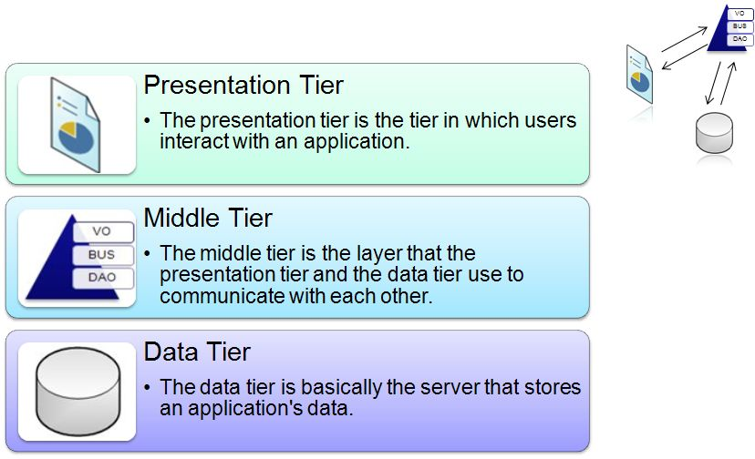
Tier vs. Layer
Tier:
  Tier indicates a physical separation of components, which may mean different assemblies such as DLL, EXE, etc. on the same server or multiple servers.

Slide 10
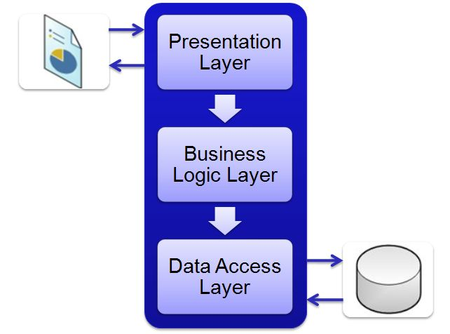
Tier vs. Layer
Layer: Layer indicates logical separation of components, such as having distinct namespaces and classes for the Database Access Layer, Business Logic Layer and User Interface Layer.

Slide 11
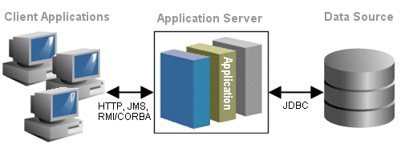
Two tier Architectures
The two-tier application programming model was developed to enhance the file server application programming model.
Improved usability
Scalability
Flexibility of applications.
2-tier architecture. The two tiers are:
  Data server: the database serves up data based on SQL queries submitted by the application.
  Client application: the application on the client computer consumes the data and presents it in a readable format to the student.

Slide 12
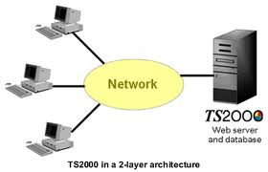
Two tier Architectures
Disadvantage:
  Every time the business rules were modified, the client application had to be changed, tested and redistributed, even when the user interface remained intact.
  If you change the type of database used by your organization, you need to redeploy and reconfigure each client application
  Database connections are limited in number and are expensive to establish
  High network traffic

Slide 13
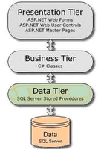
3-Tier Architecture
A 3-tier application is a program which is organized into three major disjunctive tiers.
These layers are described below.
  UI or Presentation Layer
  Business Access Layer or Business Logic Layer
  Data Access Layer
Each layer can be deployed in geographically separated computers in a network.
The characteristic of the tier communication is that the tiers will communicate only to their adjacent neighbours
Example of C/S Architecture

Slide 14
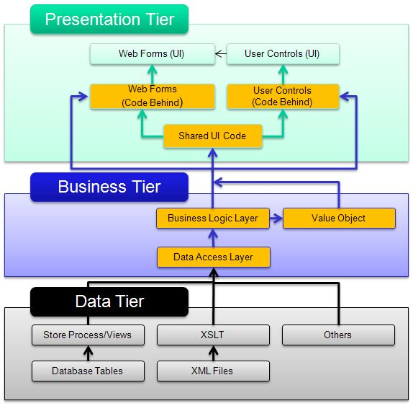
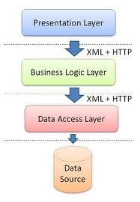
3-Tier Architecture
The Presentation Tier will interact directly with the Business Tier and not directly with Data Access or Data Tiers.

Slide 15
3-Tier Architecture
Presentation. The presentation layer provides the application's user interface (UI).
Business. The business layer implements the business functionality of the application.
Data The data layer provides access to external systems such as databases.
ADO.NET can be used directly as the data access components for simple applications. More complex applications may benefit from developing a set of classes over ADO.NET that help you to manage the complexities of object-relational mapping.

Slide 16
Advantages
Powerful re usage of code.
Every layer is rather easy to develop.
Improve data integrity
  The middle tire can only ensure that only valid data is allowed to be update in the database
Improved Security
  Client doesn't have direct communication with database
Reduced Distribution
  Only business logic need to be updated on the application server and do not have to be distributed to all clients
Hidden Database Structure
  The Actual database is hidden from direct caller

Slide 17
Drawbacks
There is more processing on the web server,
Increased complexity
  Creates an increased need for network traffic management, server load balancing, and fault tolerance.
This is a potential obstacle for simplifying maintenance and promoting code reuse throughout the organization.
Point of communication is double

Slide 18
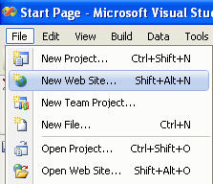
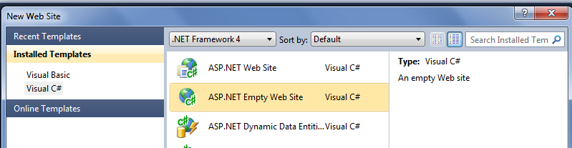
Three Layer Architecture in C# .NET
Open visual studio or visual web developer.
Go to File-> New Web Site
Select ASP.NET empty Web Site and then browse the Folder in which you want to save your web pages.

Slide 19
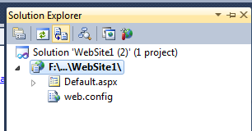
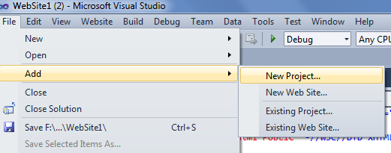
Three Layer Architecture in C# .NET
Click your web project in solution explorer
Then click new project from file menu
Click add → new project

Slide 20
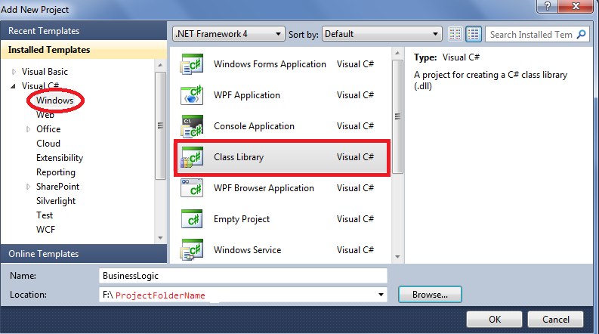
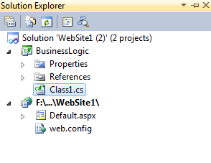
Three Layer Architecture in C# .NET
Get a template Select Windows from installed template and Select Class library
Browse the location where you created your application and click ok

Slide 21
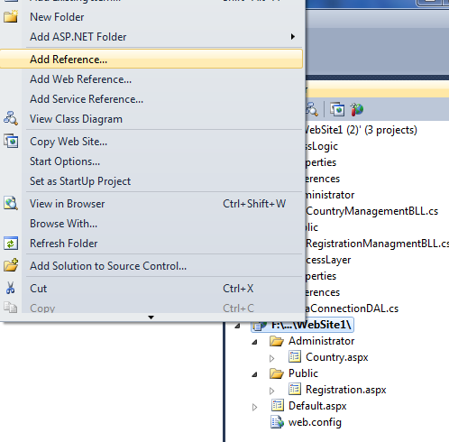
Three Layer Architecture in C# .NET
For data access layer the Steps repeat and name the class library for Data Access
Add reference to presentation to business logic
Right Click website

Slide 22
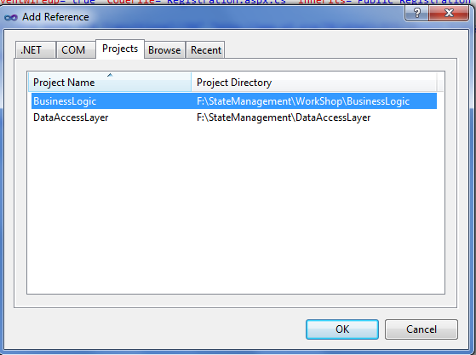
Three Layer Architecture in C# .NET
Select your business logic library file
Click OK

Slide 23
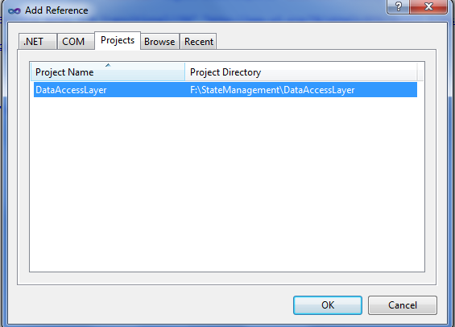
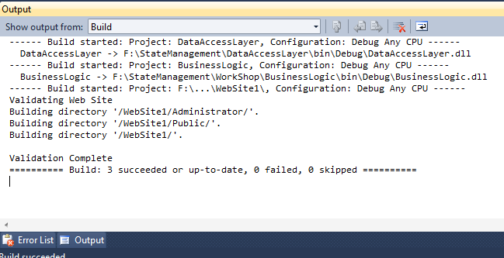
Three Layer Architecture in C# .NET
Add reference of data access layer to business logic layer
Select business logic layer
Select Add reference
Then build your project

Slide 24
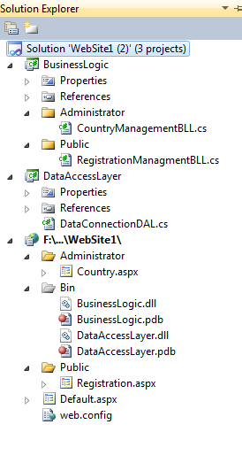
Finally
Database

Slide 25

Conclusion
Complex business rules easy to implement in application server layer
All tires can be performed independent
By using 3-Tier architecture in your project you can achieve
1. Separation - the functionality is separated from the data access and presentation so that it is more maintainable
2. Independence - layers are established so that if one is modified (to some extent) it will not affect other layers.
3. Reusability - As the layers are separated, it can exist as a module that can be reused by other application by referencing it.

Slide 26


Hit links
http://www.scribd.com/doc/19485413/3-Tier-Architecture
http://msdn.microsoft.com/en-us/library/windows/desktop/ms685068(v=vs.85).aspx
http://www.codeproject.com/Articles/11128/3-tier-architecture-in-C
http://nice-tutorials.blogspot.in/2010/10/3-tier-architecture-in-aspnet-using-c.html
http://www.slideshare.net/guestd0cc01/3-tier-architecture

Slide 27


Slide 28


